Slide 1


Smart Attendance System via OpenCV-Python
Submitted by:
Aman Pratap Shee
Atul Kumar Sinha
Pallav Pushparaj
Sankalp
MD Faiz
Pratik Kumar
Mentor
Dilip Maity

Slide 2
Outline :
1. Introduction
2. Algorithm ( flow chart )
3. Functional Block Diagram
4. Results
5. Conclusion
6. Future Work

Slide 3


Introduction :
Traditionally attendance is marked manually by teachers and they must make sure correct attendance is marked for respective student.
This whole process wastes some of lecture time and part of correct information is missed due to fraudulent and proxy cases.

Slide 4
Introduction :
In order to determine classroom attendance, face detection and face recognition are performed. Face detection is used to determine the location of the faces in the classroom image and extract sub images for each face. Then, in face recognition, the face images detected will be compared with the data base consisting of images of students in the class, and attendance will be recorded accordingly.

Slide 5




Significance:
1-Automated
2- Economically
3-Effective
4- Keep extra time

Slide 6
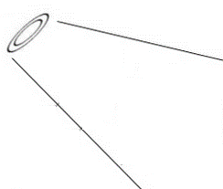
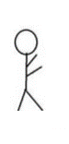
Basic Structure
Student Face
Teacher
Web Camera

Slide 7
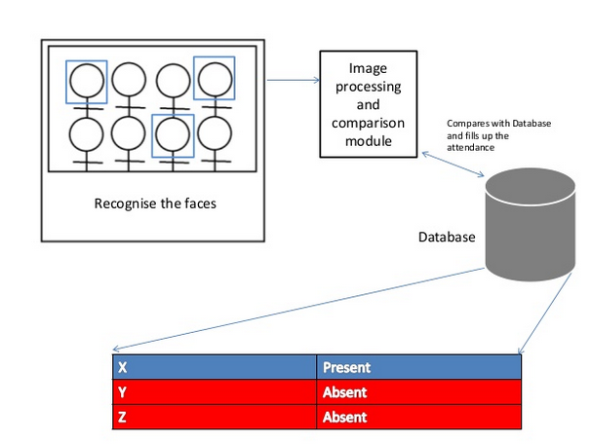

Slide 8
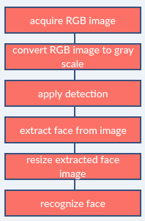
Image processing:

Slide 9
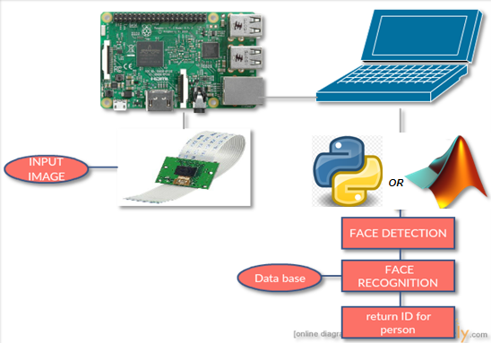
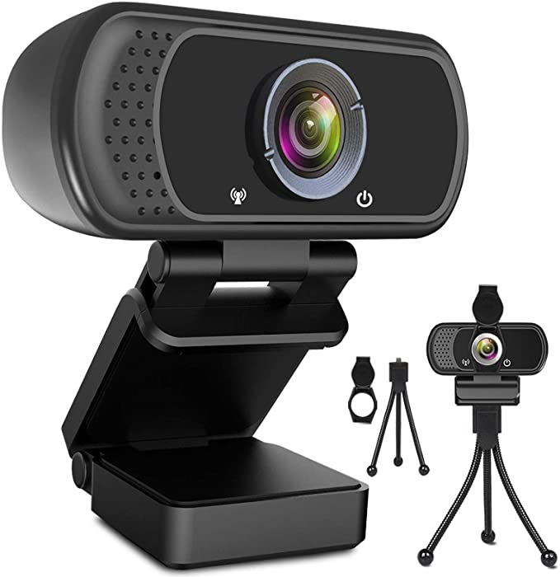
Functional Block Diagram:
The whole system should consist of

Slide 10
Face Detection:
Face detection is a computer technology used to identify human faces in digital images by determining the location of the faces in the image and extract sub images for each face.
Viola Jones algorithm will be implemented to recognize face and non-face patterns and enable us to identify locations of the faces in the image.

Slide 11
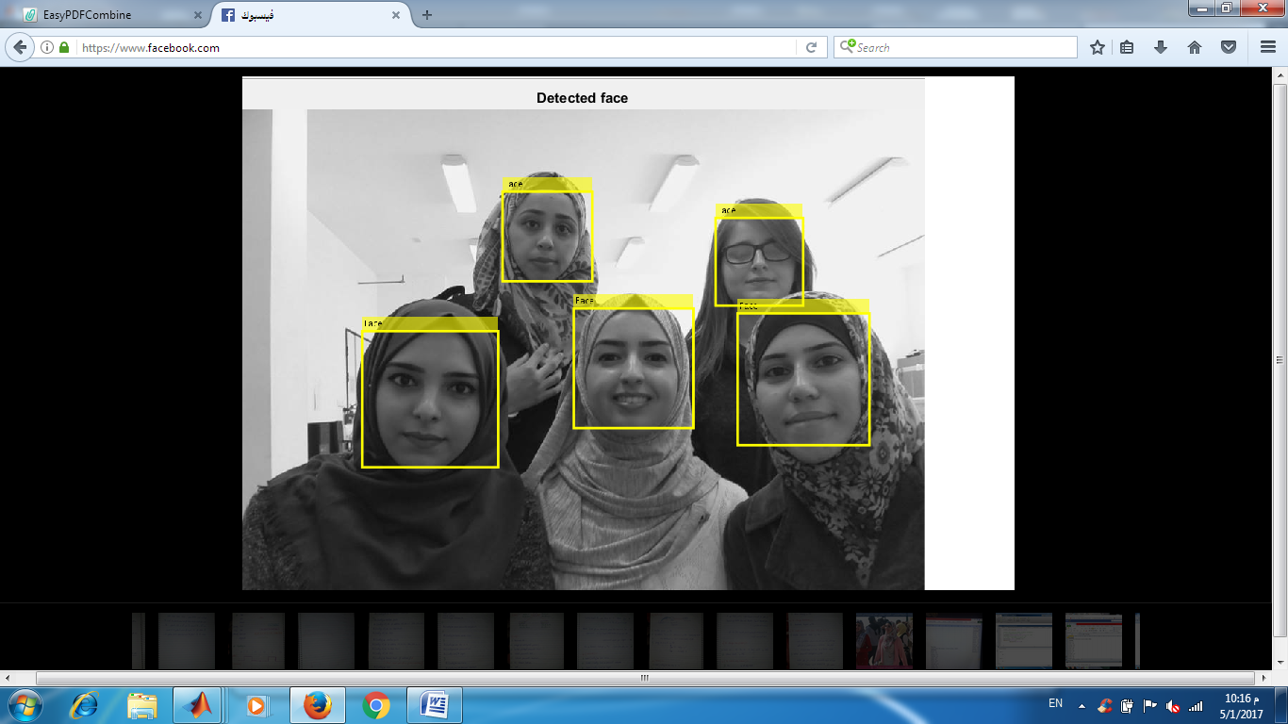
Example for detect face using openCV:
OpenCV is the huge open-source library for the computer vision, machine learning, and image processing and now it plays a major role in real-time operation which is very important in today’s systems. By using it, one can process images and videos to identify objects, faces, or even handwriting of a human. When it integrated with various libraries, such as NumPy, python is capable of processing the OpenCV array structure for analysis. To Identify image pattern and its various features we use vector space and perform mathematical operations on these features.

Slide 12
How Do We Create Database
We created a data base for 5 persons, were we took 1 image per person using webcam, these images were taken at different times and with variations in illumination, facial expressions, and facial details.
First, look at a picture and find all the faces in it
Second, focus on each face and be able to understand that even if a face is turned in a weird direction or in bad lighting, it is still the same person.
Third, be able to pick out unique features of the face that you can use to tell it apart from other people— like how big the eyes are, how long the face is, etc.
Finally, compare the unique features of that face to all the people you already know to determine the person’s name.

Slide 13
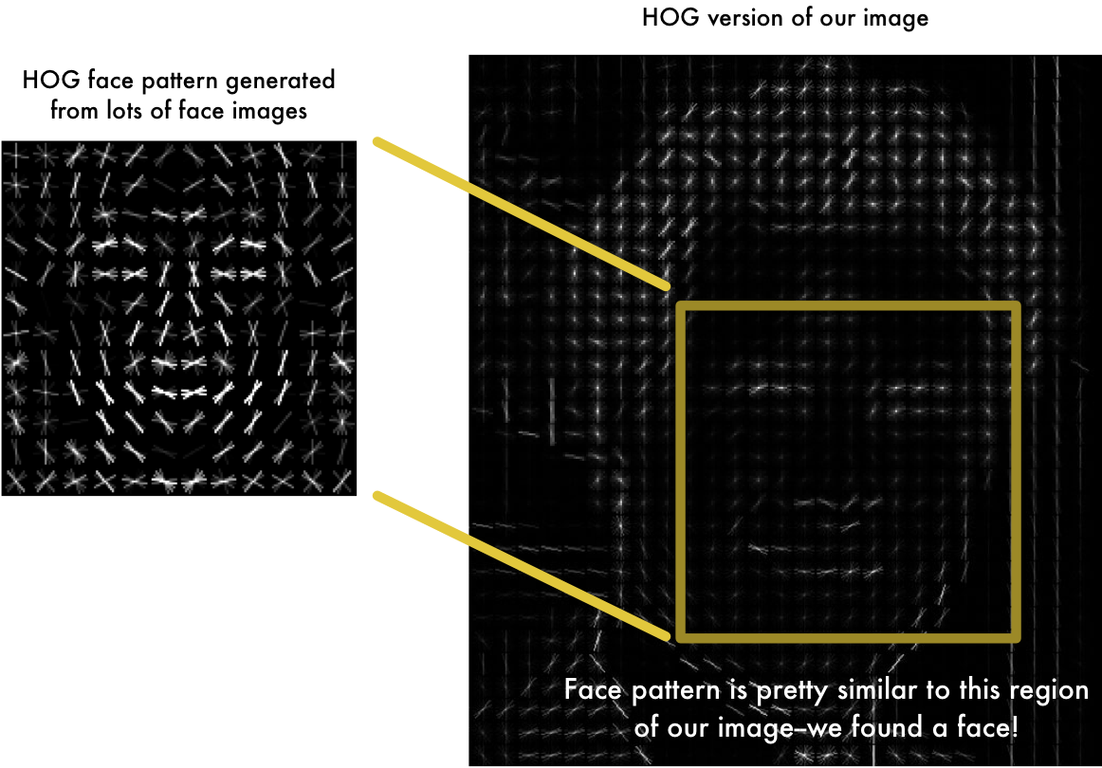
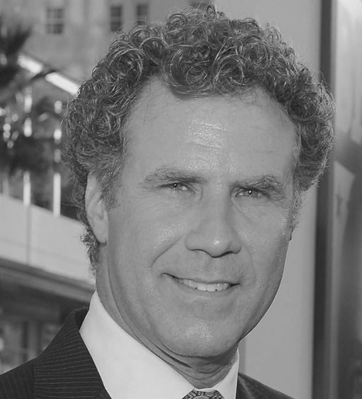
Example for data base images:
We’re going to use a method invented in 2005 called Histogram of Oriented Gradients — or just HOG for short. To find faces in an image, we’ll start by making our image black and white because we don’t need color data to find faces.
Real Image

Slide 14
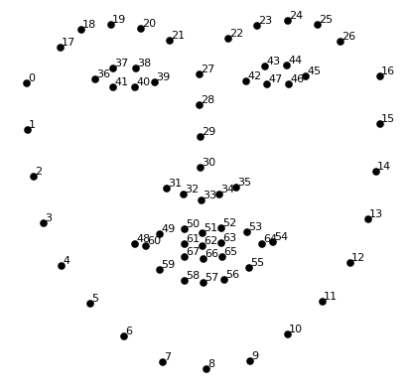
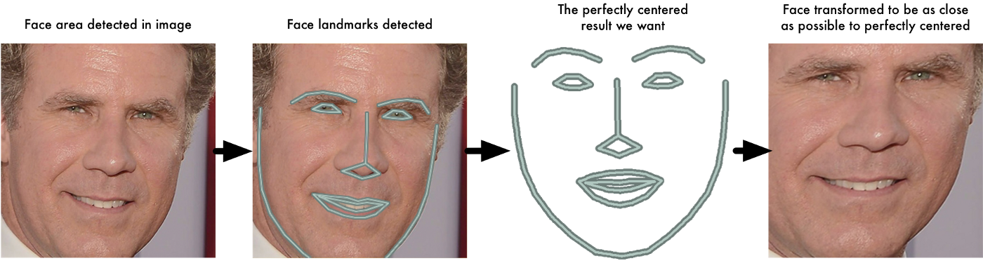
For Posing and Projecting Faces we are going to use an algorithm called face landmark estimation.
The basic idea is we will come up with 68 specific points (called landmarks) that exist on every face — the top of the chin, the outside edge of each eye, the inner edge of each eyebrow, etc. Then we will train a machine learning algorithm to be able to find these 68 specific points on any face:
The 68 landmarks we will locate on every face. This image was created by Brandon Amos of CMU who works on OpenFace.

Slide 15
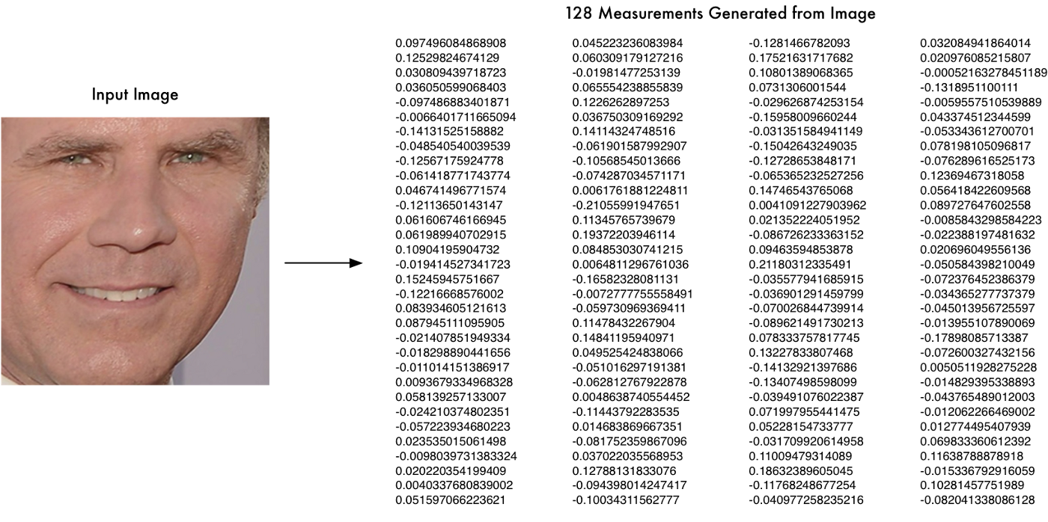
Encoding Faces
we are going to train it to generate 128 measurements for each face. Machine learning people call the 128 measurements of each face an embedding. The idea of reducing complicated raw data like a picture into a list of computer-generated numbers comes up a lot in machine learning (especially in language translation).
But once the network has been trained, it can generate measurements for any face, even ones it has never seen before! So this step only needs to be done once. Lucky for us, the fine folks at OpenFace already did this and they published several trained networks which we can directly use.
We have just shown the inner view of OpenFace
Notes:
<number>

Slide 16
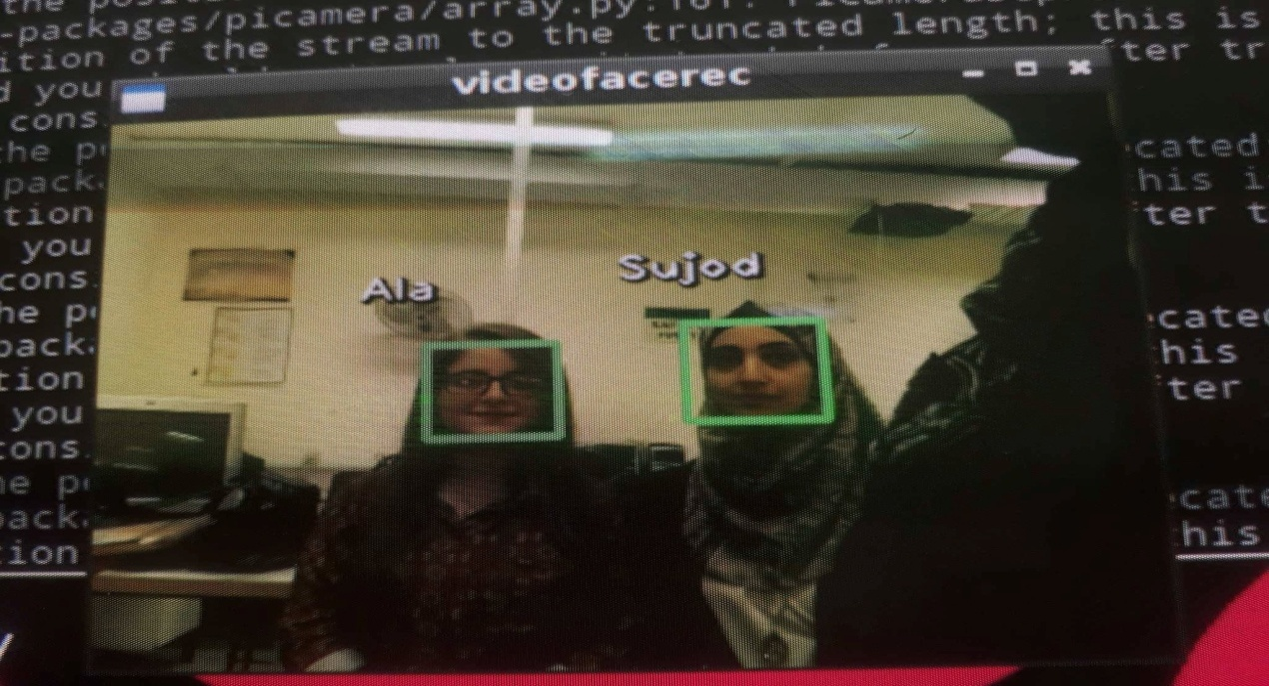
When we applied the openCV python code, the code was able to successfully recognize the faces, it detect the faces and write the names of recognized persons as shown:

Slide 17

Then the code will creates a csv file for present students as shown:

Slide 18
The problem that we faced
In our project we have faced many of problems and we have overcome them:
1- Download Python and library for it on computer system.
2- While understanding oven cv and its usage was very difficult.

Slide 19
Conclusion:
From our experiment, we noticed the face recognition was sensitive to face background, light, and head orientations. This technique described the accurate and efficient method of automatic attendance in the classroom which could replace the traditional method. An automatic attendance has many advantages, most of the existing systems are time consuming and require semi manual interference from lecturers, our system seeks to solve these issues by using face recognition in the process to save the time and labor. And No need for installing complex hardware for taking the attendance in classroom, all we need is a camera and laptop. We used algorithms that can detect and recognize faces in the image.

Slide 20
Future work
Automatic attendance system can be improved by increasing the number of features which can be extracted to increase accuracy of face recognition. Once the software is developed and tested properly, it could be improved to cover full institutions such as the faculty of engineering.

Slide 21
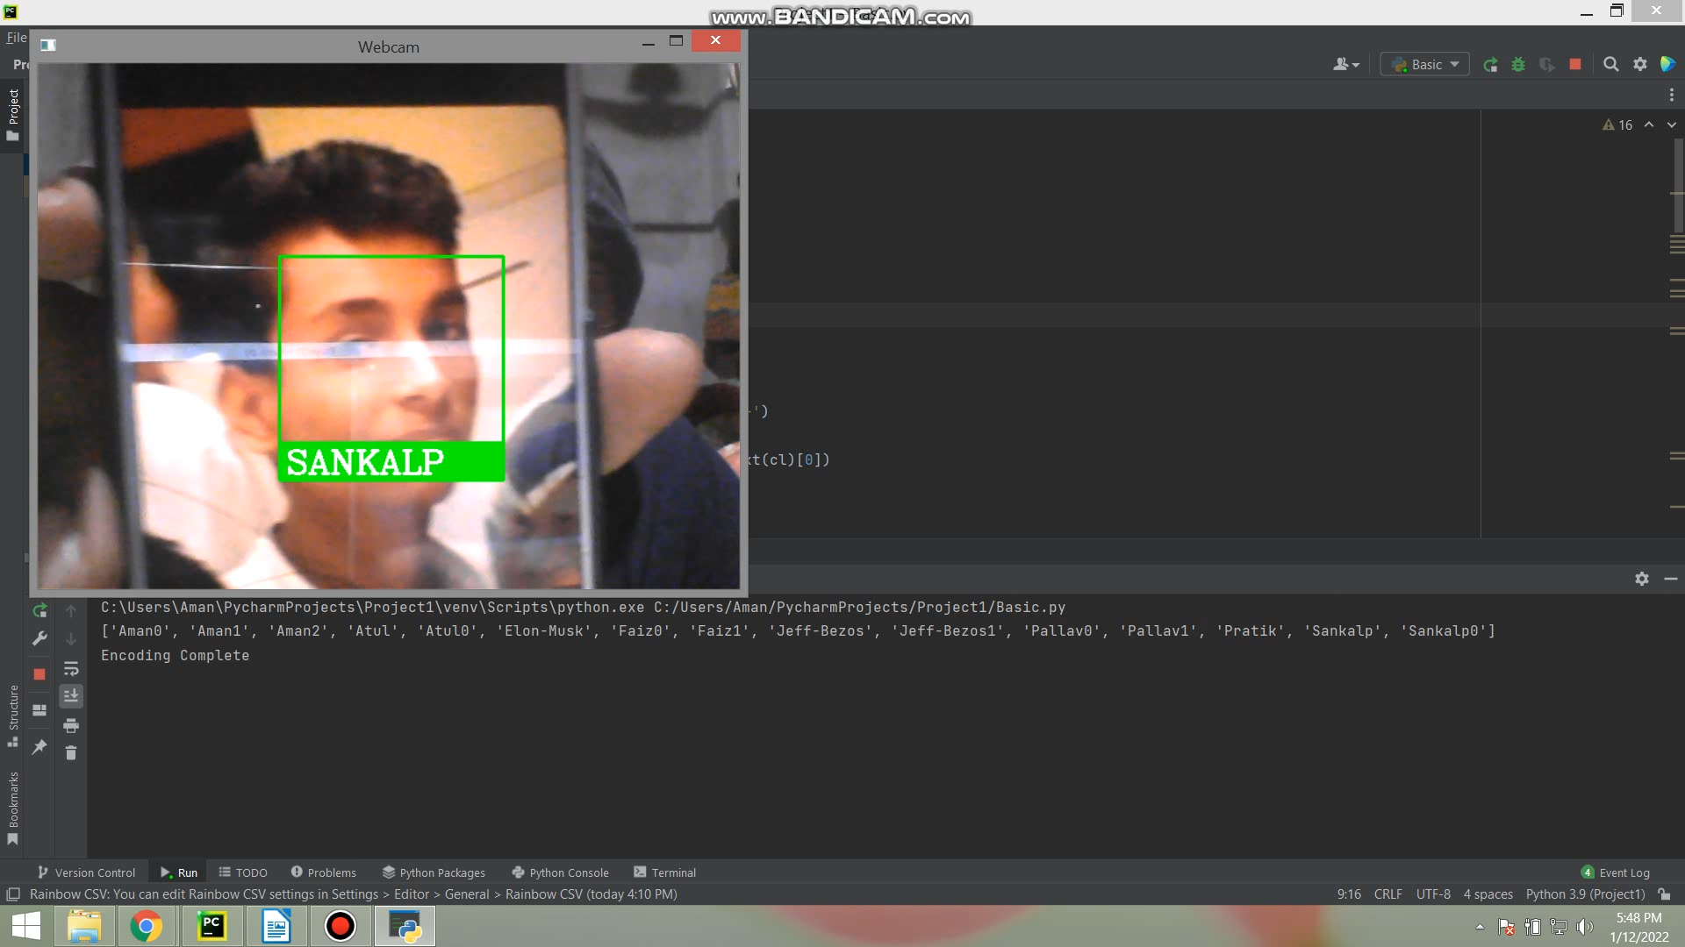
Our Sample

Slide 22


